Slide 1
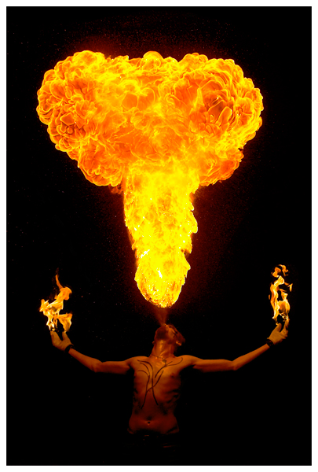
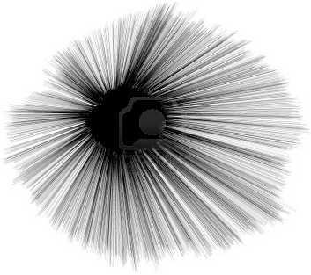
fate of unbelievers who die
fate of believers who die
Jesus comes for His bride
Jesus brings spirits of those asleep - believers get new bodies
I Thes 4:13-18
I Cor 15:51-54
Judgment Seat of Christ
II Cor 5:10
Ro 14:10
I Cor 1:10-15
Christ Returns
2nd coming
With armies (bride) from heaven to tread winepress
Rev 19:7-15
Rev 17:14
1st resurrection
Rev 20:4-6
Brings all in heaven with Him
Judgment of the nations
Mat 25:31-46
NEW HEAVEN
NEW EARTH NEW JERUSALEM
When Christ returns, His angels gather His elect from 4 winds (Matt 24:31)
It appears lost Jews are also taken (Matt 24:37-51)
It appears that His elect do not receive glorified bodies, but gathered to the land, given His Spirit, and able to reproduce (Ez 36:22-38; 37:25)
Abraham's Bosom
Paradise
Comfort
II Peter 3:10-13
2 witnesses killed and resurrected
Ascend into heaven with bodies
(Rev 11:7-12)
Great White
Throne
Rev 20:11-15
Eph 4:8-10
I Pet 3:18-20
Ps 68:18
II Cor 12:2-4
Bride
Rev 21:1-10
Rev 3:12
Sheep
Sheep's children
Nations
Rev 21:24-22:5
In natural bodies eat the leaves of the tree of life for healing
Rev 22:2
Rapture
Believers dying during this time
Rev 6:9-11; 7:9-17
Spirits go to be with Jesus
II Cor 5:1-9;
Phil 1:20-23;
John 11:25-26
Satan released
Deceives nations
Gog & Magog
Rev 20:7-9
Christ
Ascends
?
Armageddon
1000 year reign
Satan bound
Saints reign w/Christ
Those whose names not in book of life
Rev 20:15
Church Age
Rev 2-3
3 1/2 3 1/2
Years Years
Pentecost
Daniel's 70th Week
Rev 6-19
Dan 9:24-27
Matt 27:52
John 3:16
Col 2:13-15
Acts 2:27, 31
Ps 16:10
Nations killed at Gog and Magog Rev 20:9
Satan
Rev 20:10
Beast & False Prophet
Rev 19:20
OT Saints
Dan 12:1-3, 13
Sheol
Satan bound
C H A S M
Armies killed Rev 19:17-21
Lake of Fire
2nd Death
Abraham's Bosom
Paradise
Comfort
Hades
Abyss
Rev 20:1-3
Cowardly, unbelieving, abominable, murderers, immoral persons, sorcerers, idolators, all liars
Rev 21:8
Fire and Torment
Death & Hades
Rev 20:14; I Cor 25:26
Luke 16:19-31
Sheol (OT) - region of departed souls - lost or believing - Hades (NT)
Not physical grave nor permanent region of the lost - not hell

